Slide 1

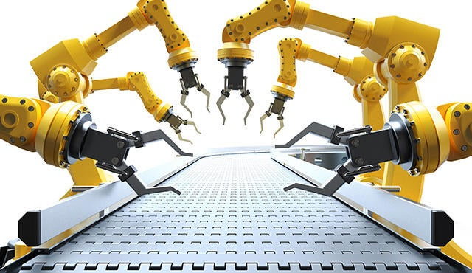

SHARED CONTROL-BASED BIMANUAL ROBOT MANIPULATION
Daniel Rakita1 *, Bilge Mutlu1 , Michael Gleicher1 , Laura M. Hiatt2 – SCIENCE ROBOTICS 2019
- Manohar akula
Asu id:1223335191

Slide 2

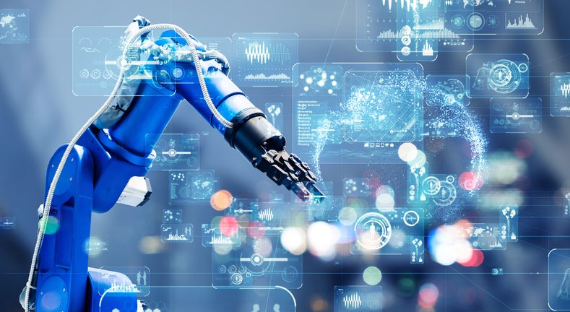
Outline
Introduction
Methods
Results
Discussion
Critics

Slide 3
Introduction
Problem Significance:
Standard bimanual control systems have not been able to handle the various, dynamic, and complicated coordination's between two arms to execute bimanual tasks, hence robots built to function in, and physically interact with, these settings have not been able to satisfy these criteria.
This research paper provides a bimanual shared-control mechanism, we were able to have robots execute bimanual tasks more successfully. The control system moves the robot's arms to mirror the operator's arm motions while also providing on-the-fly support to make jobs easier for the user. A BIMANUAL ACTION VOCABULARY was utilized in our strategy.
The Bi-manual Action vocabulary employs a sequence-to-sequence recurrent neural network architecture and activates a related help mode, which sends signals into the shared-control loop to aid in the execution of a specific bimanual action.

Slide 4
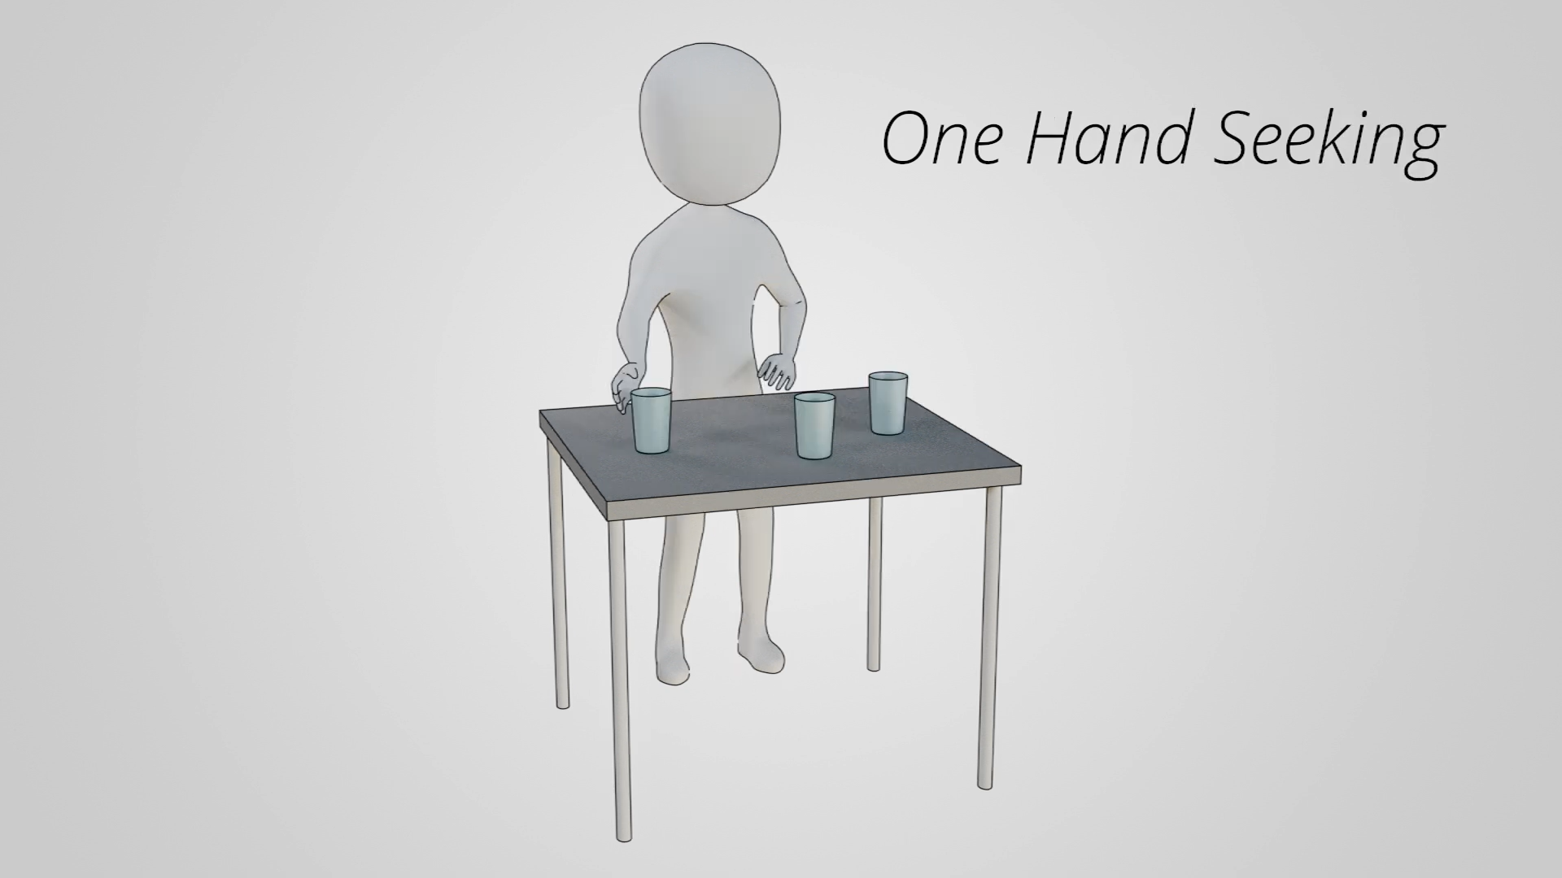
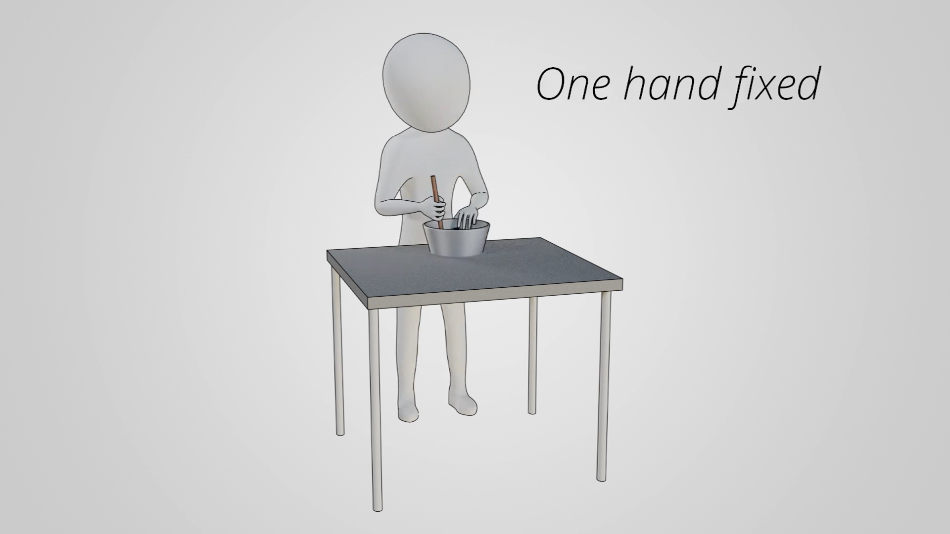
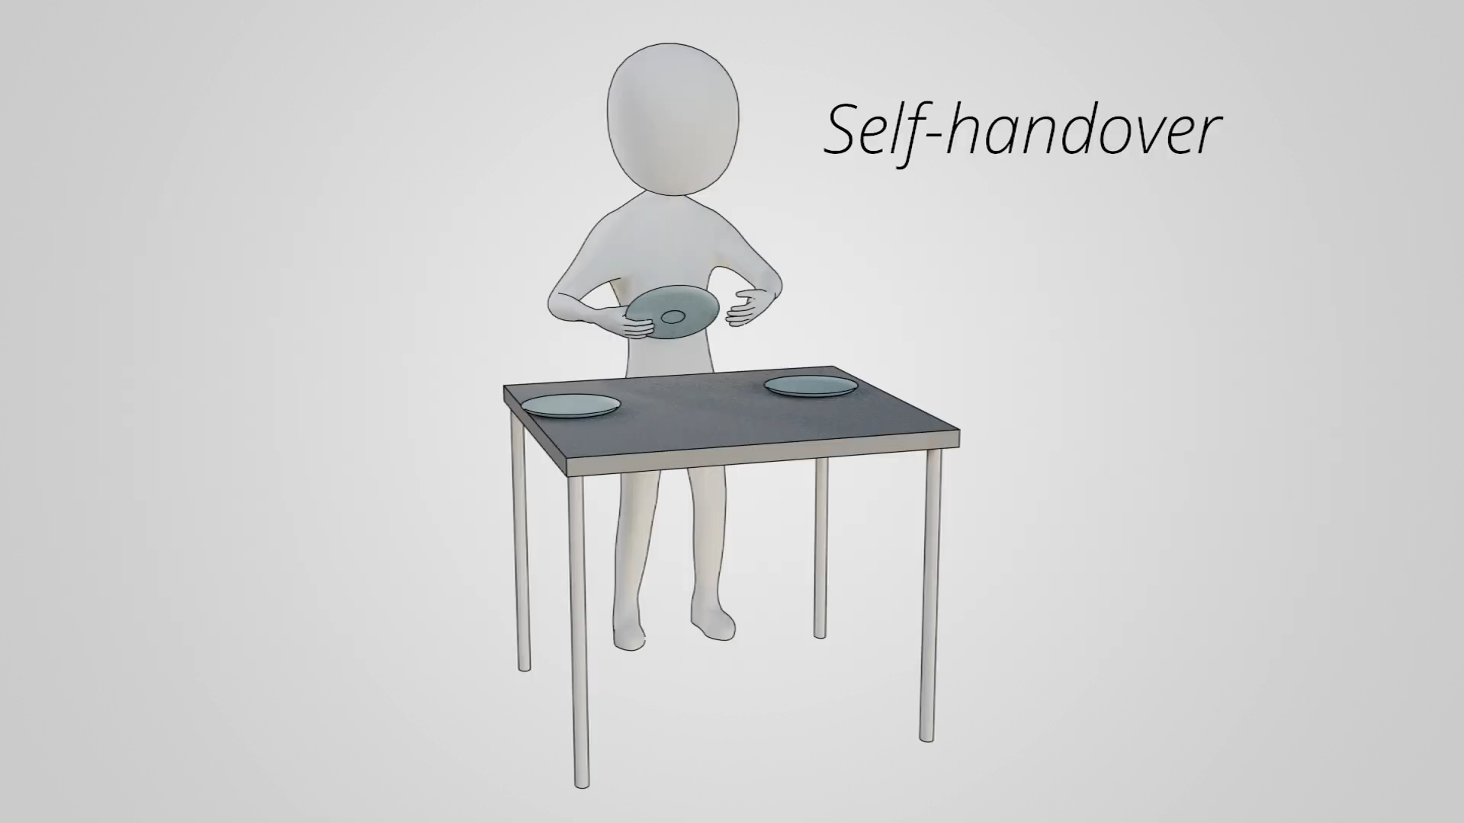
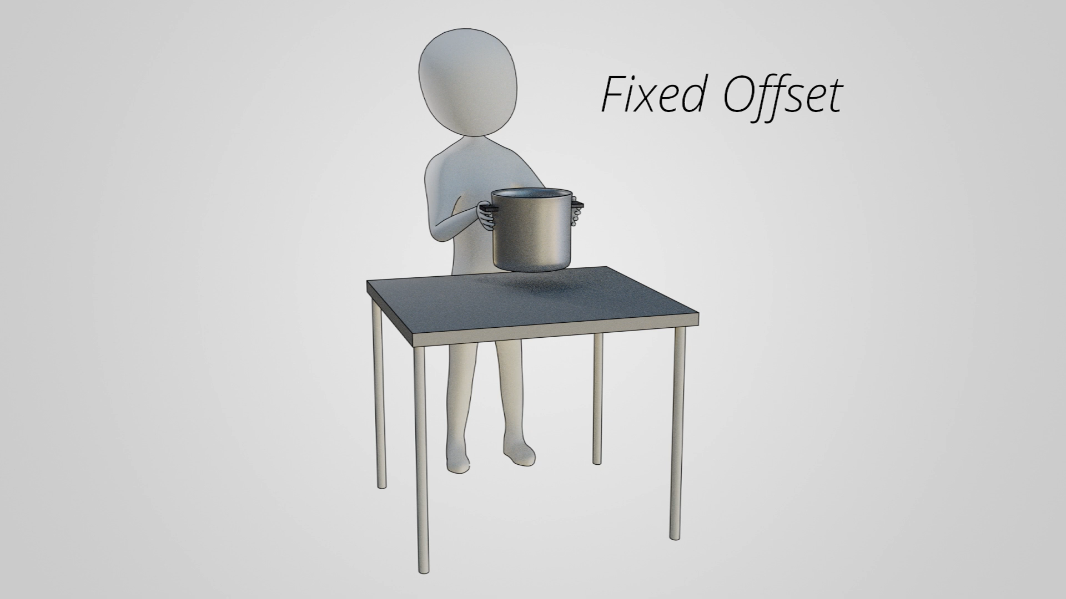
Approaches:
Two-handed, or bimanual, manipulations are encouraged in human-centered workplaces. Since the evolution of neuronal mechanisms in our forefathers' brains to promote interactions between the two hands, communities have adapted their environments to accommodate these talents, allowing complicated tool usage, manual work, food preparation, and communicating gestures.
Examples:
To open a jar, secure it with one hand while twisting the lid with the other.
When holding a bowl in place while stirring with the other.
Raising a laundry basket with both hands gripping the handles on either side.
Sliding dishes from one hand to another when laying the table for supper

Slide 5
METHODS:
Previous Methods:
Robots Approach towards Bimanual Tasks:
Historically, robot platforms have been created with only one arm. As a result, altering either the job or the environment is required to enable such robots to do bimanual tasks.
This single arm constraint has been found to make robot movements more difficult to perceive and relate to and represents a significant obstacle to realizing robots' full potential for working in human environments and supporting people in everyday chores.

Slide 6
People Approach towards Bimanual Tasks:
Previous research in the fields of neuroscience, neurophysiology, and rehabilitation reveals that the brain areas specialized to bimanual movements, such as the supplementary motor area and primary motor cortex, show distinct neural patterns.
Scientists used a brain-machine interface to effectively control the bimanual arm motions of rhesus monkeys by targeting the parts of the brain associated with bimanual movements rather than targeting the brain regions associated with right- and left-arm unimanual movements individually.
These previous approaches were fails to prove “GESTALT PHENOMENON” that any solution for bimanual motion planning, control, or manipulation that excludes the centralized action semantics or dynamic function switching inherent in bimanual actions is ineffective.
GESTALT PHENOMENON:
- Each arm's distinct actions are encouraged to achieve more than the sum of its parts.

Slide 7
Proposed Method:
To overcome the gestalt effect involved in the Bimanual manipulations, authors captured the unique two-handed human movement types that might benefit from a specific control method.
The objective was to capture the numerous, dynamic, and intricate actions and interactions that occur often during bimanual manipulations in such tasks, as well as to provide control mechanisms that support these interactions. 3 solutions for three technical challenges for the Robot.
Organizing the range of Bimanual manipulations.
Identifying the Action needed to do a task.
Strategy to implement for each Bimanual manipulations.

Slide 8
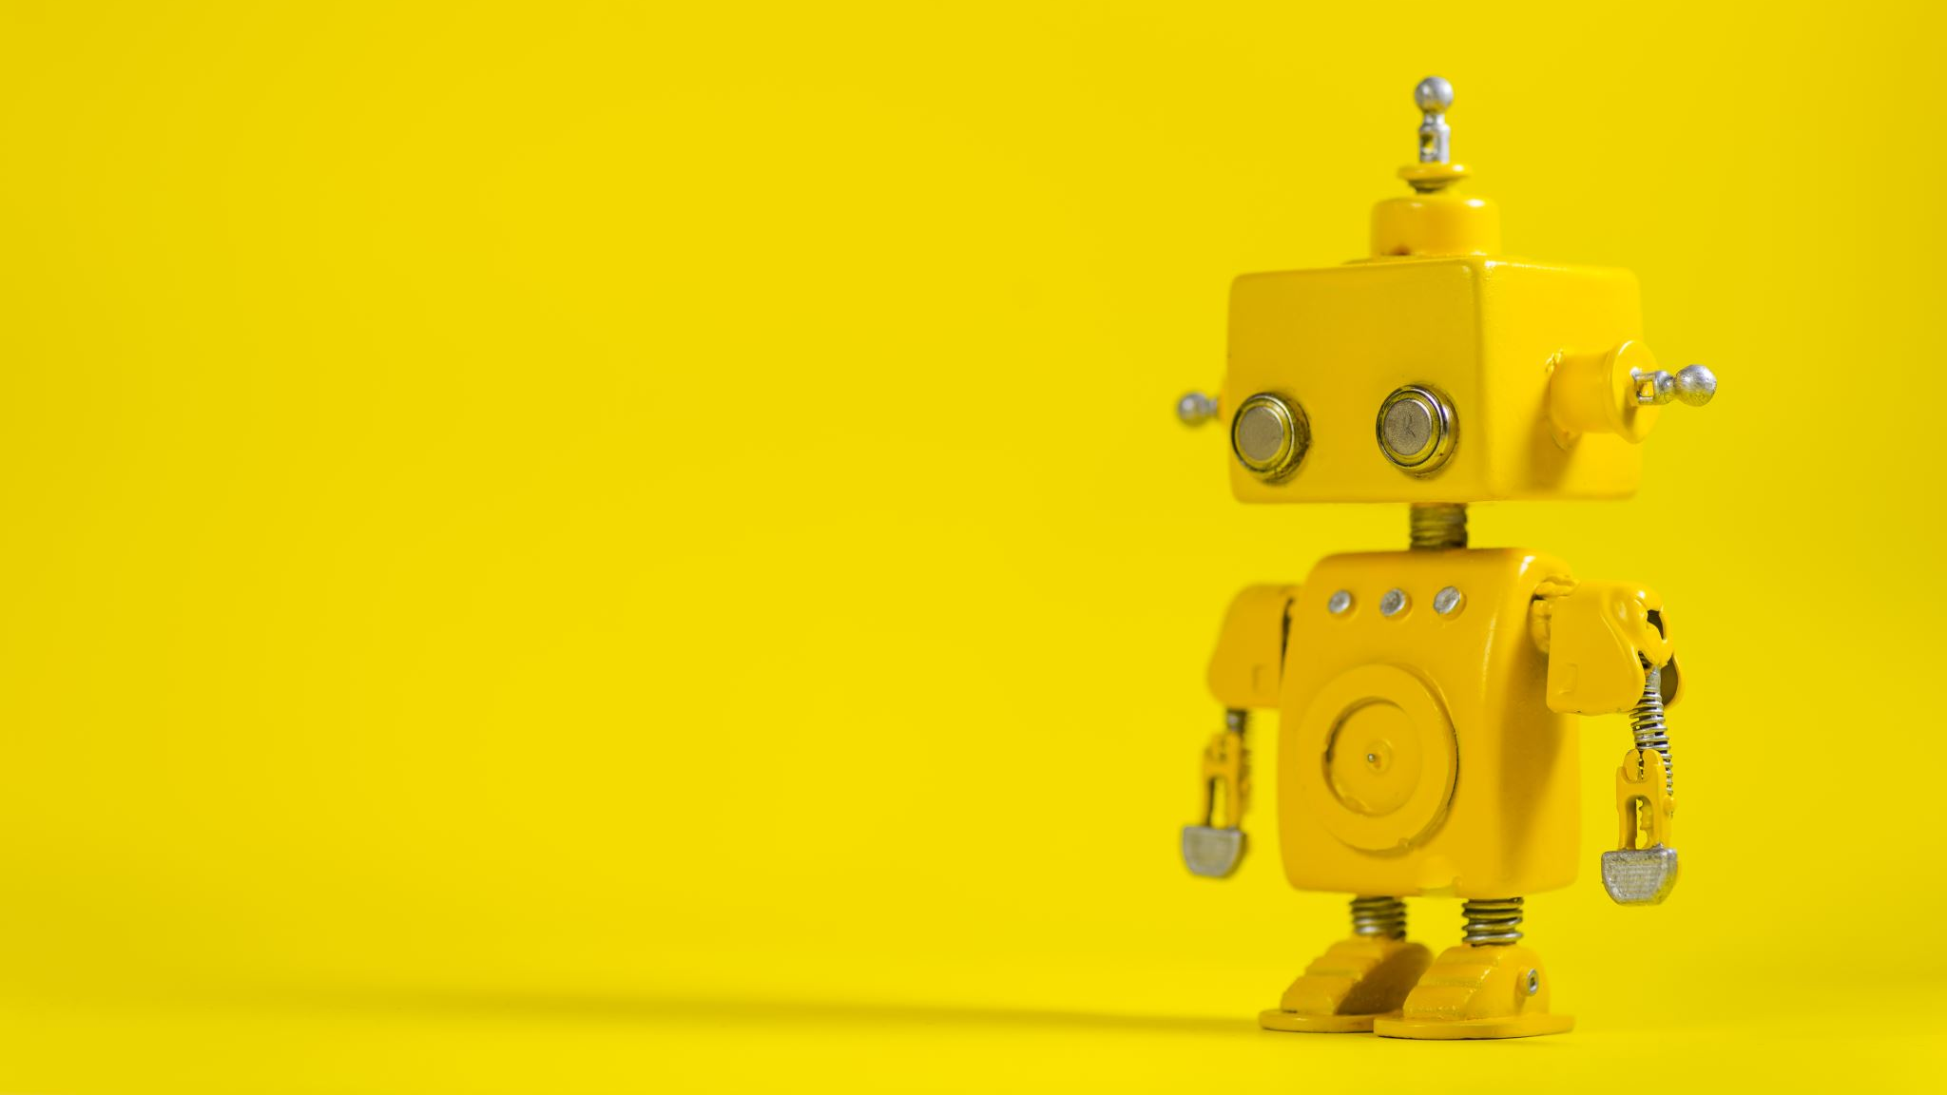
This process include:
Recording the Bimanual Tasks
Constructing a Bimanual Action Vocabulary
Controlling Robot in a real-time using mimicry – control
Recognizing a Bimanual Action in Real – Time
Engaging Assistance Mode
Assisting during Bimanual Motion Control

Slide 9
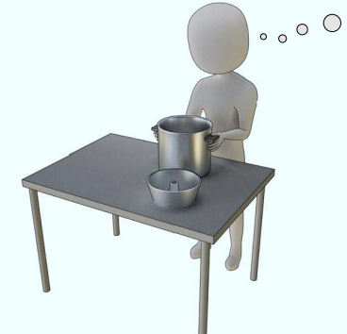
Recording The Bimanual Tasks :
The authors gathered data from 12 people who performed a variety of Bi manual manipulations with the purpose of extracting high-level patterns to create a data set that may be used to inform bimanual robot motion algorithms.
The Bi-manual manipulations are generally built up from a small set of central kinematic actions these actions are self-handover where the hands come together to pass an object from one hand to the other one hand fixed where one hand holds an object in place so the other hand can perform a manipulation.

Slide 10
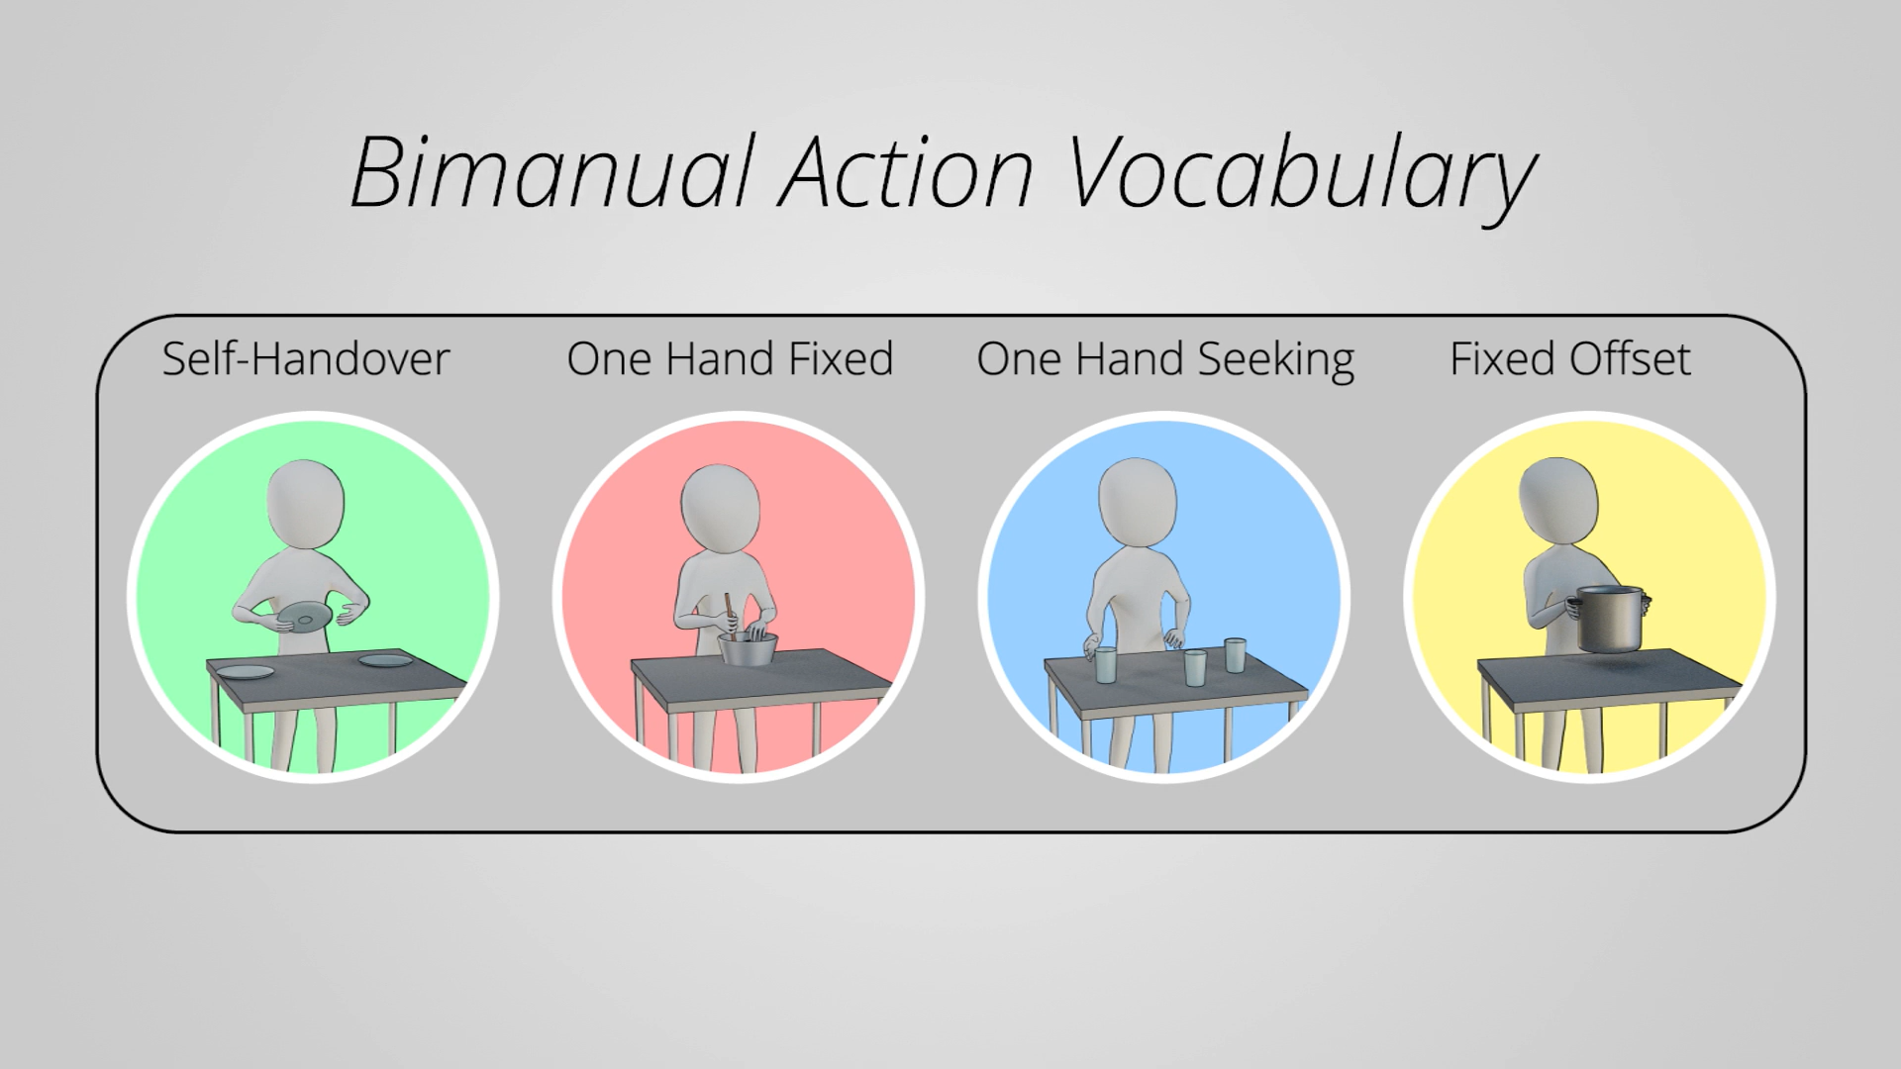
Bimanual Action Vocabulary :
It is a versatile and understandable language that was created to define the bimanual manipulation space. An analysis of the language reveals that it might be used as an effective abstraction level for telling the robot how to do bimanual activities.
It’s Bimanual action vocabulary algorithm includes the different data sets of the following
Self-Handover
One Hand Fixed
One Hand Seeking
Fixed Offset

Slide 11
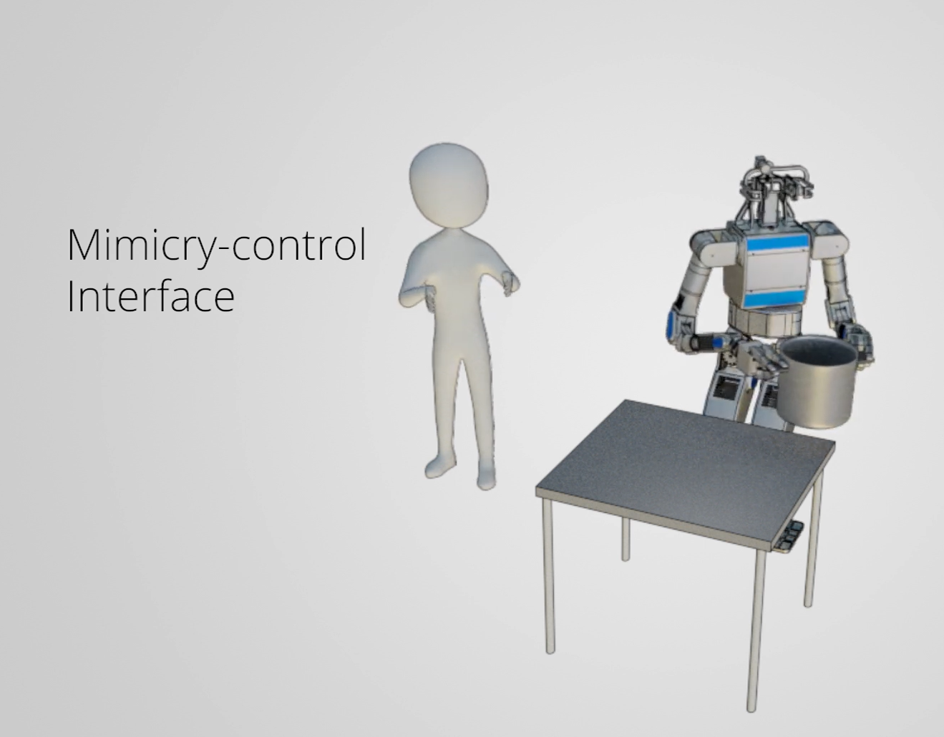
Controlling Robot In A Real-time Using Mimicry – Control :
Mimicry control records the user's hand positions at each update, allowing the user's hand motions to be mapped in real time to the robot's end effectors. Motion retargeting entailed transferring motion from one articulated figure (e.g., a teleoperator, motion-capture actor, etc.) to a possibly significantly different articulated figure while maintaining critical motion or posture features. This method allows users to tell the robot what tasks they want it to execute by easily and naturally moving their arms in the desired direction.

Slide 12
Recognizing A Bimanual Action In Real – Time :
Using a sequence-to-sequence recurrent neural network to infer which bimanual action from the bimanual action vocabulary that the user is most likely trying to specify to the robot from a recent stream of the user's hand poses.
Engaging Assistance Mode & Assisting During Bimanual Motion Control :
The presumed bimanual motion At the moment, the technique has dynamically activated a suitable aid mode, which are signals supplied into the shared-control loop to facilitate the performance of a certain bimanual activity easier or more efficient.

Slide 13
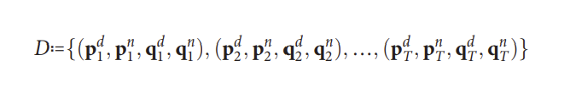
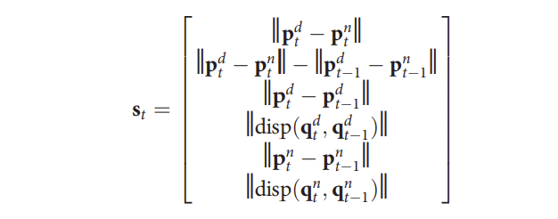
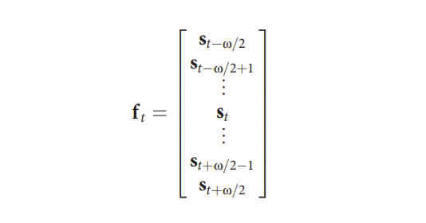
Procedure :
Recording the dataset of participants' hand poses over time while performing various bimanual tasks.
Filtering the dataset so that data signals are not conflated with extraneous noise.
Analyzing the dataset to see what high-level patterns emerge when people perform bimanual tasks.
Organizing the observed bimanual patterns into a bimanual action vocabulary.
Data set structured as
Single Time Point structured as
Vector to encode motion structured as

Slide 14
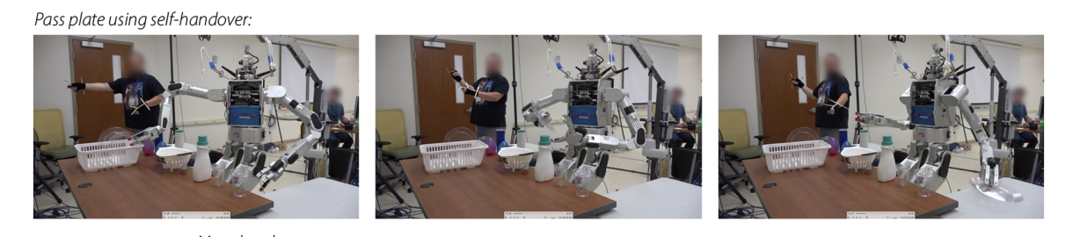
RESULTS:
Passing plates from the robots right to left end effector to place the plates into the drying rack
With Out Assistance Mode -
The exercise is difficult for the participant to complete since the distance between the robots and effectors does not match the distance between the user's hands.
With Assistance Mode –
When executing self-handovers, the robot adjusts its end effector translation velocities to match hand velocities perceived by people. It also ensures that its end effectors are the right distance apart from each other, as chosen by the user, to allow for a genuine self-handover motion.

Slide 15
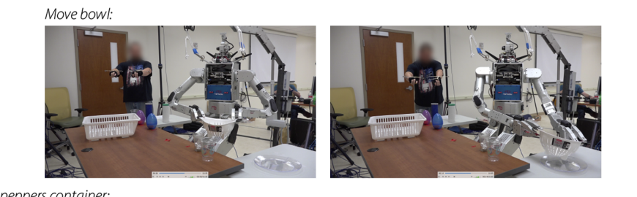
2. Moving the trash bin from one table to another using both hands directly using two robot arms
With Out Assistance Mode -
This assignment is difficult to complete because the arms are unaware that they are working together to move a stiff item, resulting in huge mistakes in motion outputs from tiny inaccuracies in motion inputs
With Assistance Mode –
The robot recognizes the presence of a fixed offset action and maintains a fixed translation and rotation offset between its end effectors throughout the action. With this help, the participant completes the job successfully.

Slide 16
Discussions :
The authors formalized a shared-control system meant to allow successful execution of bimanual tasks in this study, extending robot manipulation skills to encompass two arms.
When task intuition and related support offered by the proposed bimanual action vocabulary were removed from the robot control scenario, researchers found no benefit in utilizing two robot arms over a single robot arm.
Across a wide range of manipulation activities, the employment of help modes based on a bimanual action vocabulary improved task success and user perception.
Thus, a successful bimanual shared control strategy requires the capacity to dynamically switch between help modes, such as when employing our suggested sequence-to-sequence recurrent neural network inference technique.

Slide 17
CRITICS:
This proposed research work is very well constructed and can be used to make Human life easier, and it can help to handle the works such as remote home care, nursing or nuclear materials handling.
But this method is limited to addresses the kinematics of the bimanual platform instead of examining the dynamics of manipulations
This method is limited to work with only 4 assistance modes such as Self-Handover, One Hand Fixed, One Hand Seeking, and Fixed Offset. But the robot gets confused if the participant performed other than these assistance modes.
Introducing additional help modes to compliant control laws that specify how the arms should work together to manipulate things.

Slide 18
CRITICS (contd…..)
This proposed research work is very well constructed and can be used to make Human life easier, and it can help to handle the works such as remote home care, nursing or nuclear materials handling.
This technique only addressed motion at the level of the user's hand positions; however, including high-fidelity finger motion and dynamics data at the users' fingertips would give rich data to reinforce both our bimanual action vocabulary and the consequent help modes.
This method's help modes were hand-crafted and based on heuristic decisions. By implementing Imitation learning and Artificial Intelligence to the Robot’s neural network can expand the usage in the medical and defense areas.
This study solely demonstrates the advantages of a single-arm controller. Other bimanual control approaches might benefit from the action-based control methods.

Slide 19
CRITICS (contd…..)
This research only evaluated scenarios in which the user was colocated with the robot and had a direct line of sight to the workspace. But in real-world use cases, the robot would likely be deployed in a remote location, making the visibility issue a relevant factor.
When manipulating a robot arm remotely, the remote telemanipulation highlighted the need of situational awareness. Moreover, they did not take into account the issue of remote visibility while operating two arms at the same time.
Methods that automatically offer a user commanding a bimanual robot platform with an effective perspective of a distant environment would strengthen the existing shared-control method.

Slide 20

References-
The Science Robotics - Shared control–based bimanual robot manipulation (science.org) - DOI: 10.1126/scirobotics.aaw0955 /2019
Google Photos

